Slide 1

“Laying the Foundations for Life.”
Year 3
Mrs McLaughlin & Miss McKay

Slide 2
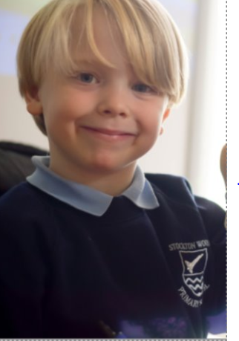




Class Timetable
What does the structure of my child’s day look like in Year 3?
Doors open at 8:50am
When children arrive at school, there is a morning task for them to complete which helps them get ready to learn.
A timetable for the day is put onto the whiteboard.
Children have access to a core curriculum, including English and Maths. They also enjoy learning as scientists, historians, geographers, musicians and artists – these are our Foundation subjects.
End of school day is 3:20pm.
Year 3 have P.E. on a Friday this half term.
Find out more about your child’s curriculum on our school website! Click the “curriculum” tab.

Slide 3
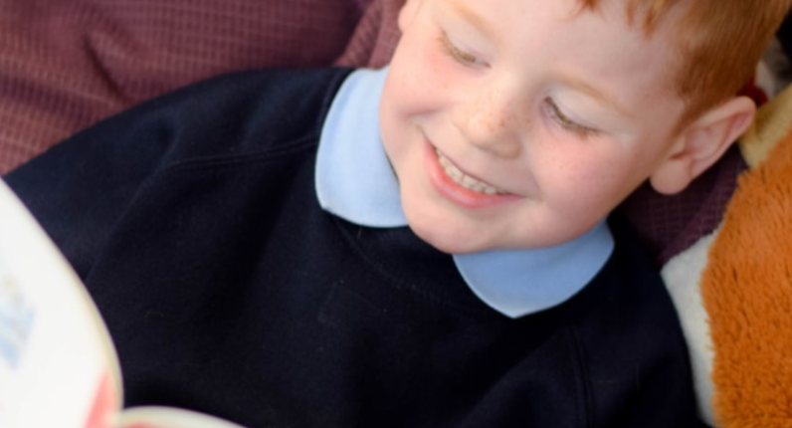
A More challenging curriculum
English
Year 2 Year 3
Correctly use capital letters and full stops most of the time
Use past tense correctly most of the time
Use conjunctions such as: and, but, so
Spell many common exception words
Make phonetically plausible spelling
Use finger spaces
Form lower case and capital letters correctly
Use prefixes and suffixes within writing
Different use of apostrophes (possession and contraction)
Wider range of conjunctions, such as: when, if, although
Use of adverbs, prepositions and expanded noun phrases
Understand, recognize and spell different homophones
Use inverted commas for direct speech
Use a range of punctuation such as , ? !
Proofread and edit work
Join handwriting

Slide 4
A More challenging curriculum
Maths
Year 2 Year 3
Recognise hundreds, tens and ones
Add and subtract up to 2-digit numbers with minimal exchanges
Measure in cm and m
Recognise a half, quarter and third
Multiplication and division facts of 2, 5 & 10
Doubling/halving
Count pounds and pence
Tell time to 5 minutes (analogue)
Compare numbers to 1000, 10 or 100 more or less
Add and subtract up to 3-digit numbers with exchanges
Find equivalent lengths (mm, cm and m)
Find unit and non-unit fractions of objects/numbers and shapes, e.g. 4/8 of 64
Multiplication and division facts of 3, 4 & 8
Division with reminders, e.g. 77 ÷ 8
Add/subtract money and find change
Tell time to the minute (analogue and digital)

Slide 5
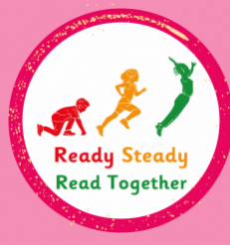



Ready Steady Read Together is taught daily in Year 3. It is a comprehension lesson that focuses on a topic each unit. Each lesson focuses on vocabulary and looks at how to find evidence in the text to find the answer.
Read Write Inc is taught daily in groups based on children’s stage of reading.
During the lessons, children learn to recognise a range of sounds. They practise blending to read words and segmenting to spell.

Slide 6
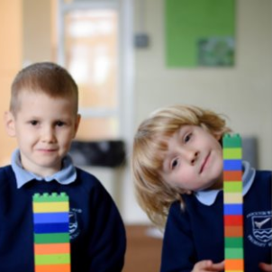
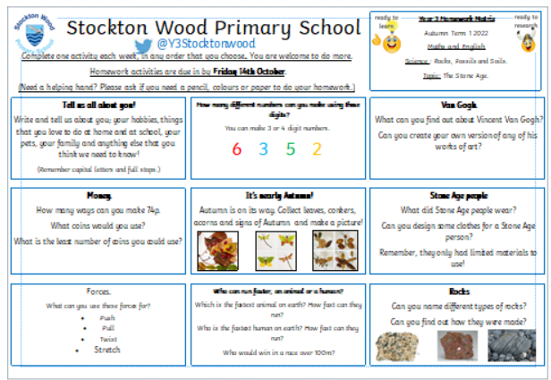
Homework
How can I support my child’s learning at home?
Each half term your child will receive a matrix of home learning activities to choose from.
These link to our curriculum learning and topics.
Your child will be rewarded with Dojos when they return a completed task!

Slide 7


Homework
How can I support my child’s learning at home?
To help secure basic skills and consolidate learning you can:
Listen to your child read for 10 minutes at least three times a week.
Practise spellings that are given out weekly.
Practise the set times table for the week.
Spellings and times tables will be tested every Friday.

Slide 8
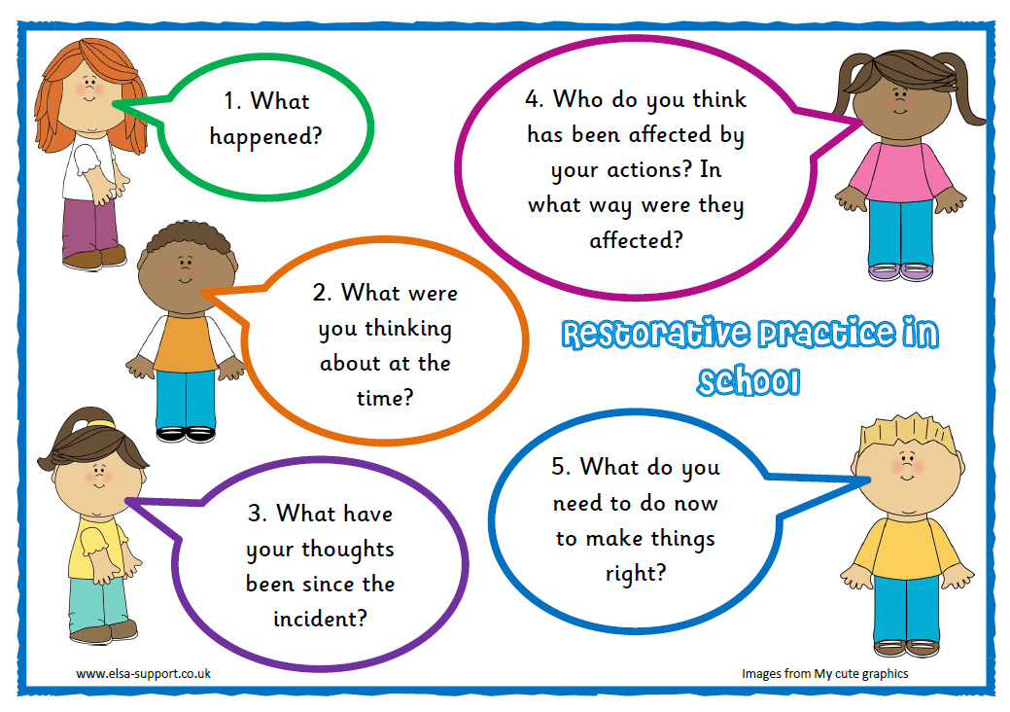
Stockton Wood is a
Restorative School!
Restorative Practice complements and supports our Behaviour Policy. You can read this on our website.
Currently, our school values are:
              Respect
              Include
              Succeed
              Encourage

Slide 9

Stockton Wood is a
School!
LifeSavers aims to equip our pupils with the knowledge, skills, attitudes and experiences to manage money well, now and in the future.
Throughout the academic year we explore Five Big Questions About Money.
We also explore four core values around money: thankfulness, wisdom, justice and generosity.
Would you like to join our Supersavers Savers Club?
If so, please let the office know!

Slide 10
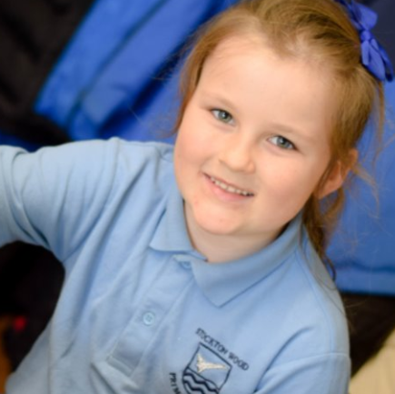
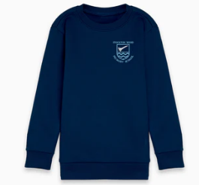
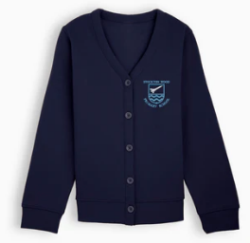
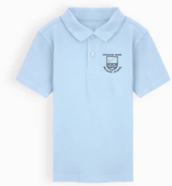
School Uniform
Be SMART and dress the “Stockton Wood Way!”
Children will need:
• Navy sweatshirt/cardigan.
• Sky blue polo shirt (with or without logo)
• Grey trousers.
• Navy skirt/pinafore.
• Plain Black school shoes/trainers (all year)
*If trainers are worn, they MUST have NO LOGOS and be COMPLETELY BLACK.*

Slide 11

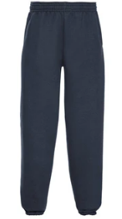
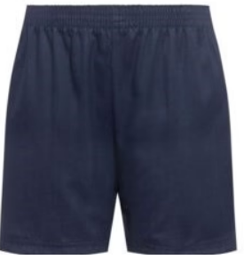
School Uniform
Be SMART and dress the “Stockton Wood Way!”
For P.E children will need:
Navy shorts, leggings or jogging bottoms
Sky blue PE shirt (with or without logo)
Black pumps or trainers
*If possible, please put your child's name on all uniform*

Slide 12
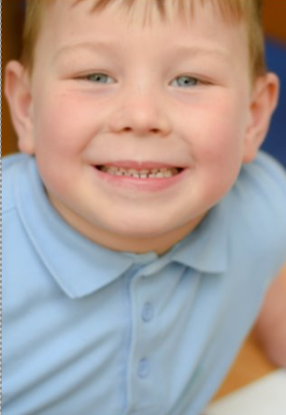
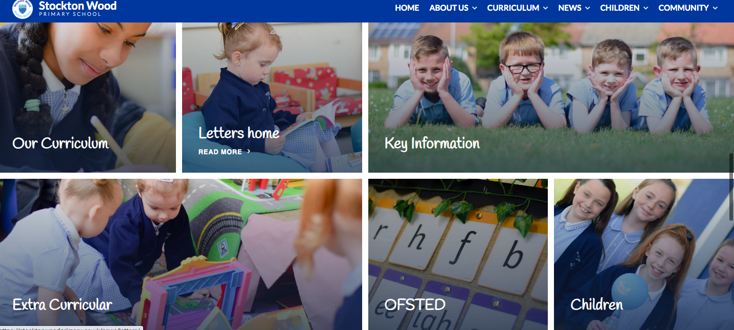

Stay Connected!
How will I know what my child is learning?
Where will I find out about school events?
Check out our school website: www.stocktonwoodprimary.co.uk
You can select the “children” tab on the school website to check out our “Chats” from the week!

Slide 13
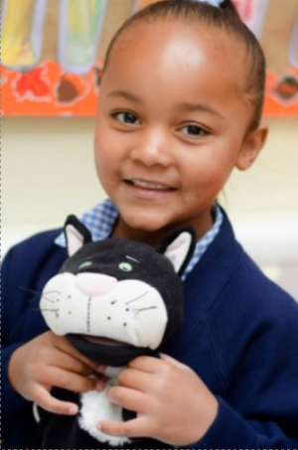




Top Tips!
What else do I need to know?
We encourage your child to bring a water bottle to school everyday – hydrate and concentrate! Only plain or sugar free flavoured water please – no fizzy water or juice!
Children are encouraged to bring a healthy snack to have at break time.
Put notifications on for e-mails from school.
Arbor is the parent platform where you sign up for clubs etc.

Slide 14
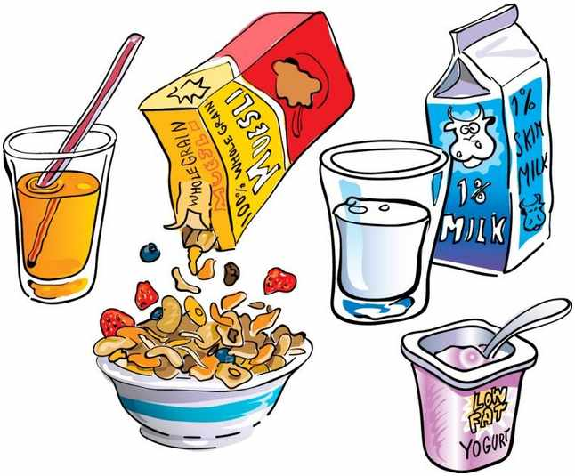

Top Tips!
What else do I need to know?
Stockton Wood offers a Breakfast Club (8:15am start). This is a great way to make a positive start to the school day including time to enjoy a mindful or team building activity!
We also offer a NEW After School Club! We are looking forward to working with Aidan and Stephen from Full of Beans.
For more information on this please contact the office.

Slide 15
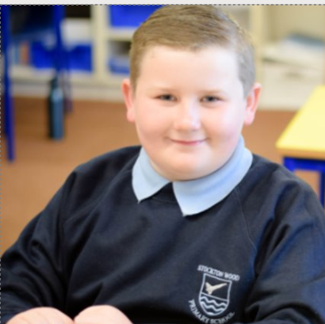
Attendance Matters!
In Stockton Wood we are…
The school day starts at 8:50am.
The school day finishes at 3:20pm.
We would like our children to achieve 100% attendance but sometimes due to illness this is not possible, therefore we have a target of 97% for all children.

Slide 16
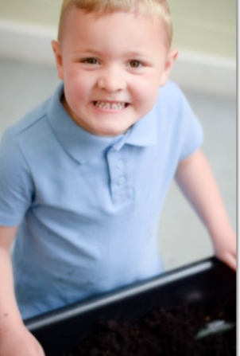
Free School Meals
What do I need to know?
Universal free school meals are available to all children in Reception, Year 1 and Year 2.
You can check to see if you are entitled to free school meals at the following websitehttps://liverpool.gov.uk/benefits/free-school-meals/application-form/
OR visit the 'One Stop Shop' based at the local library.
It is important to register for your entitlement to free school meals, even if your child has a packed lunch.

Slide 17
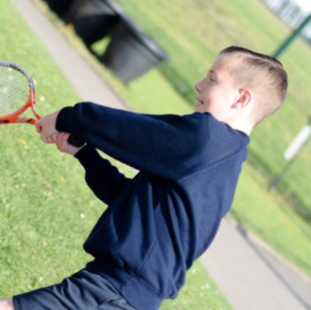
‘Stay and Learn’
Come and join in the learning fun!
On 23rd October at 2:45
parents/carers will be welcomed into school to join in with a curriculum activity. We can’t wait!
These will take place every half term. At Stockton Wood we love to share our love for learning.

Slide 18
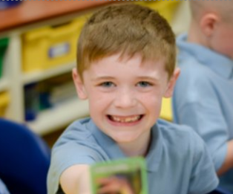
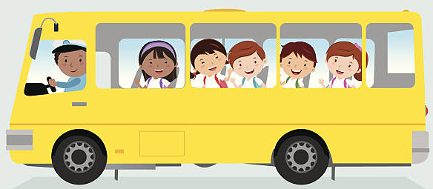
School Trips
Exploring learning outside the classroom
At Stockton Wood we believe school trips are important for children as they provide hands-on learning experiences, foster social development, and help connect classroom lessons to the real world.
In Year 3, we have at least three trips planned throughout the year, and we would greatly appreciate any volunteers who are able to help support us on these outings.

Slide 19
Any questions?

